Slide 1
Fundamentals of Unit Testing

Slide 2
Characteristics of a Good Test
First-class Citizens
Clean, Readable, maintainable
No logic
Isolated
Not too specific/general

Slide 3
What to Test and Not to Test
Testable code is Clean , Clean Code is Testable
If the code is clean:
Test the outcome of a method
There are two Types of a function
Query Function – These are function that returns a value
Command Method – Performs an action e.g. Writing to a value. In this test the outcome.

Slide 4
Don’t Test
Language Feature
3rd Party Code

Slide 5
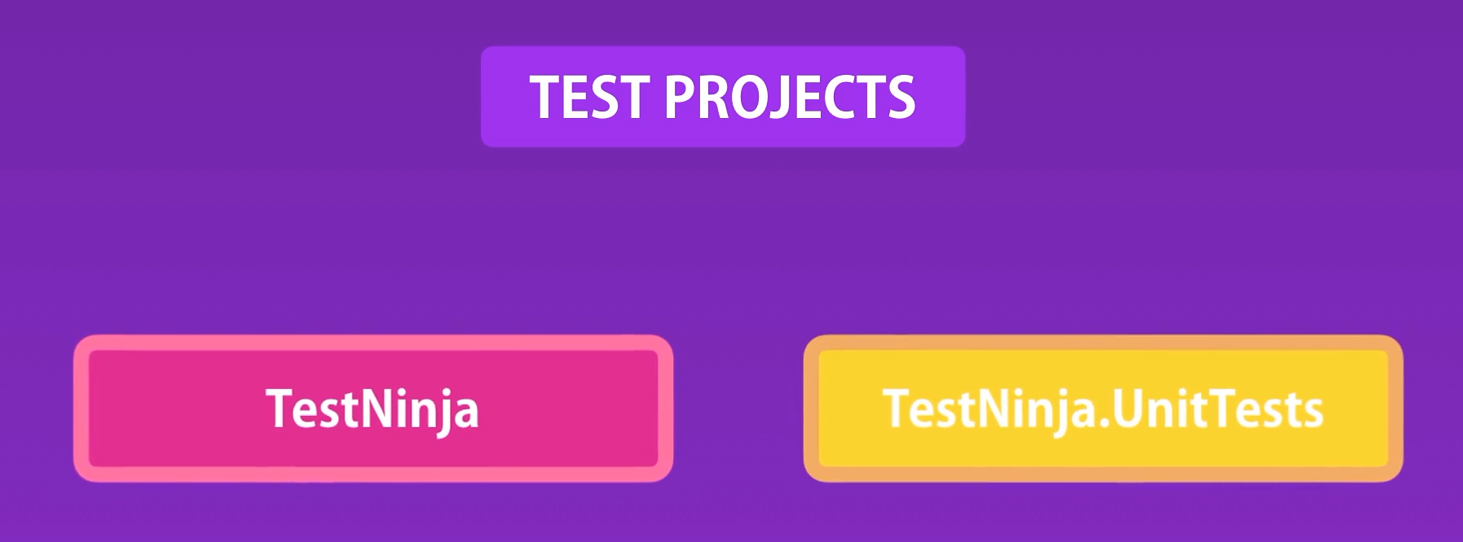
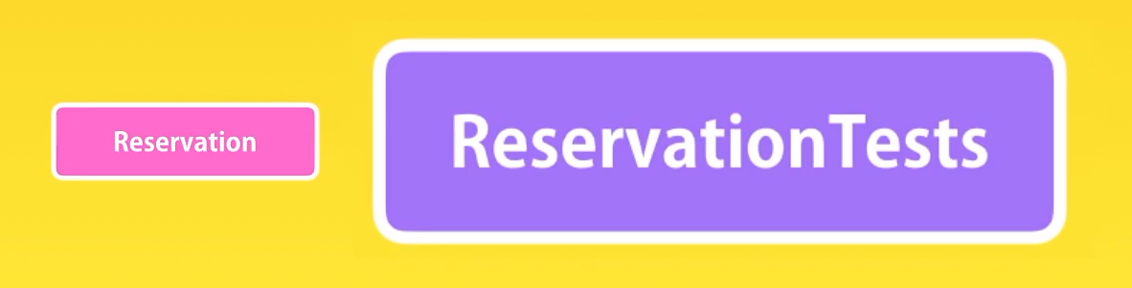
Naming and Organizing Tests

Slide 6
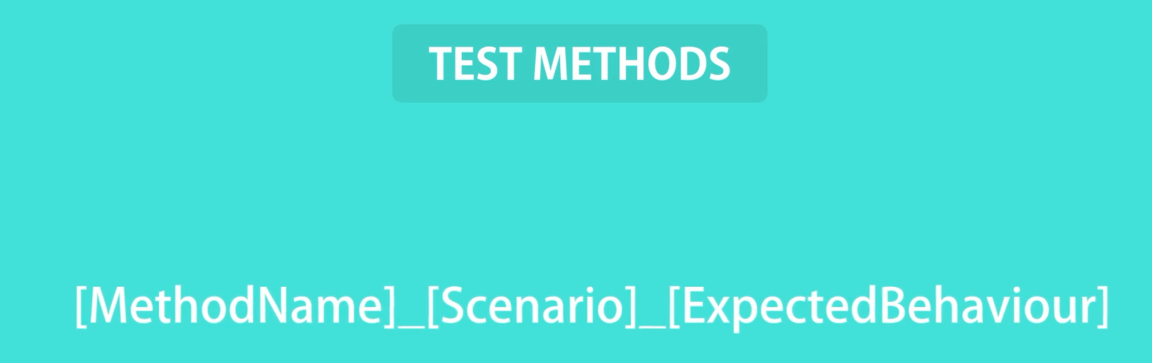
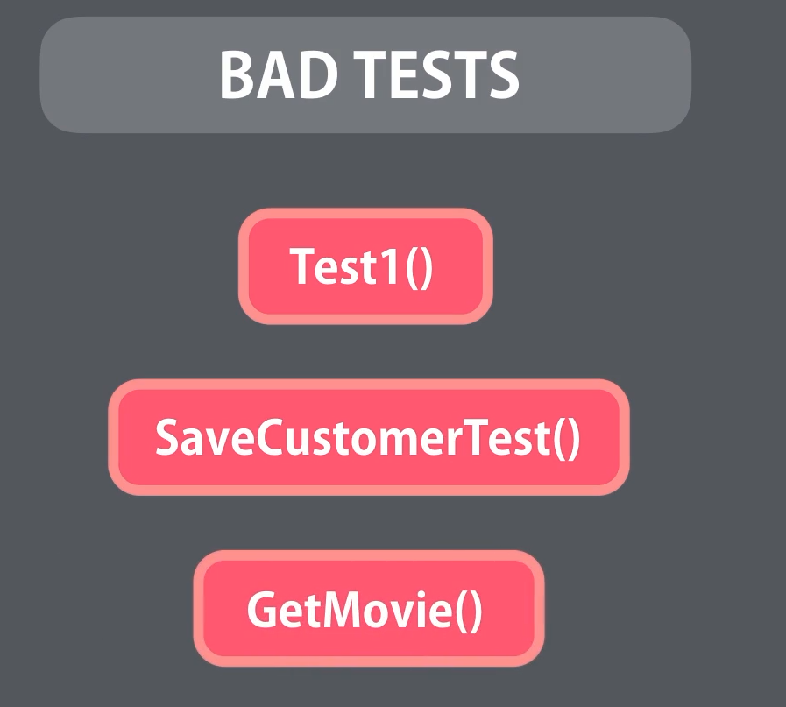
How many Tests?
Depends on what you are testing, often the Number of test => Number of execution Paths.
The name of your test should clearly specify the business rule you’re testing.

Slide 7
Black Box Testing
Black Box Testing is a software testing approach where we examine an application without knowing its internal code or structure. It's like treating the software as a closed box, where we only focus on its inputs and outputs, not how it works inside.
Testers create test cases based on the software's requirements and design, without looking at the underlying programming. This helps ensure that the software functions correctly from a user's perspective, without being biased by its internal complexities. Black box testing allows us to validate if the software behaves as expected, just like real users would experience it, without needing to be familiar with the technical details.

Slide 8
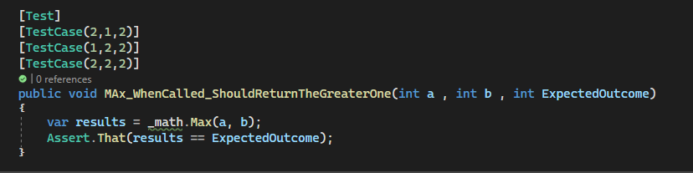
Parameterized Test
NB: This is found in Nunit Framework and not in MSTest

Slide 9
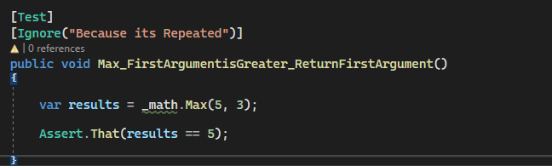
Ignore Test
Commenting a Test is not Good , but ignoring is better since it reminds you that you still need to check on that test later. The ignore notation is found in both MSTest and Nunit frameworks.

Slide 10
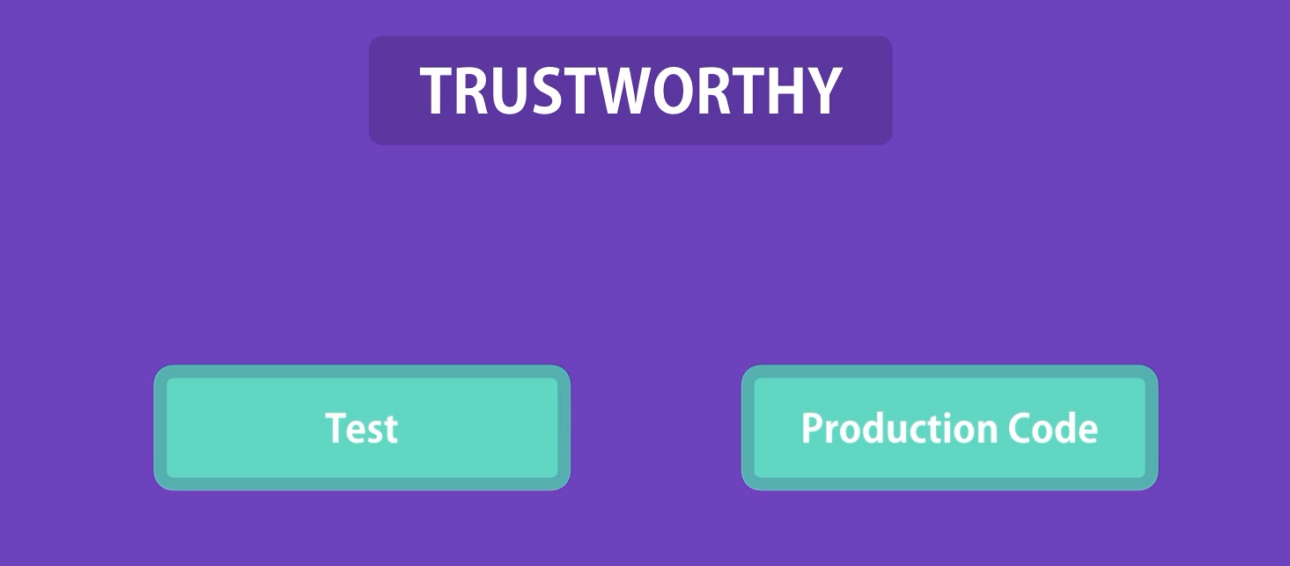
TrustWorthy Test
There are two ways to write a TrustWorthy Tests:
Use TDD – We have been using Code first approach so far these means that our tests can pass but the code is wrong
Create a Bug in your Production Code intentionally and see if you tests are passing or failing

Slide 11
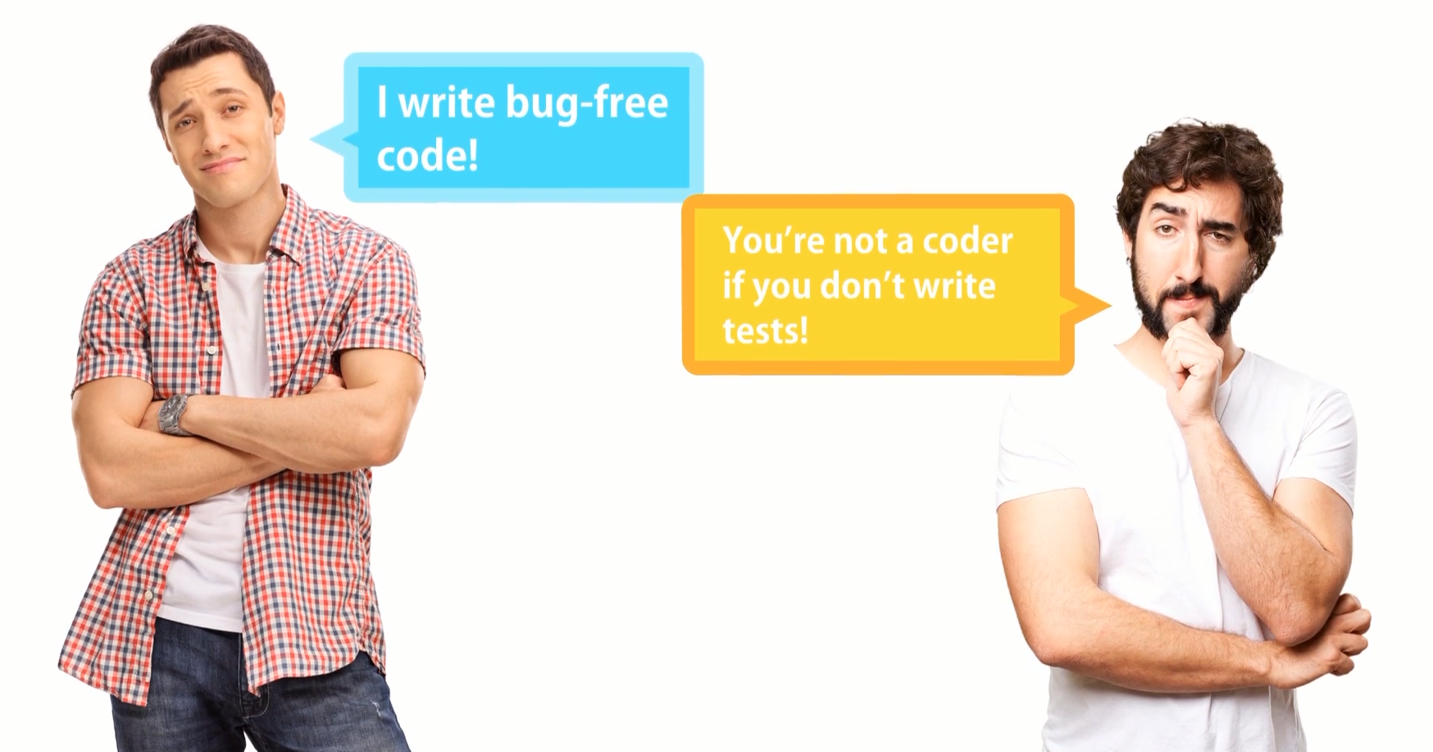

Slide 12
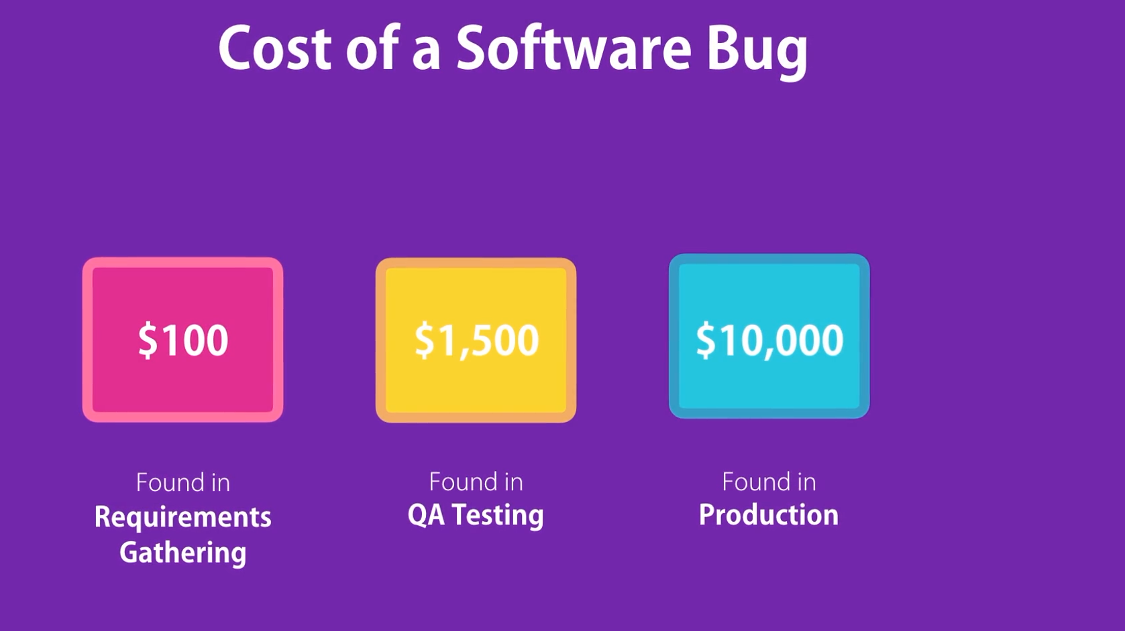

Slide 13
